Slide 1


Technical Terminology and Mathematics of Logistic Regression, MND, and Decision Tree
This presentation delves into the technical aspects of Logistic Regression, Multinomial and Ordinal Logistic Regression (MND), and Decision Trees, focusing on their mathematical underpinnings.
by Lokesh Belekar

Slide 2

Introduction to Logistic Regression
1
Predicting Binary Outcomes
2
Probability Estimation
Logistic Regression is a statistical method used for predicting binary outcomes, such as whether a customer will purchase a product or not.
The model estimates the probability of an event occurring, given a set of independent variables.
3
Classification
Based on the estimated probabilities, the model classifies observations into two categories.

Slide 3
Fundamentals of Logistic Regression: Sigmoid Function and Log-Odds
Sigmoid Function
Log-Odds
The sigmoid function is a mathematical function that maps any real number to a value between 0 and 1, representing probability.
Log-odds, or the logit, transform probabilities into a linear function, making it easier to estimate coefficients using linear regression methods.

Slide 4
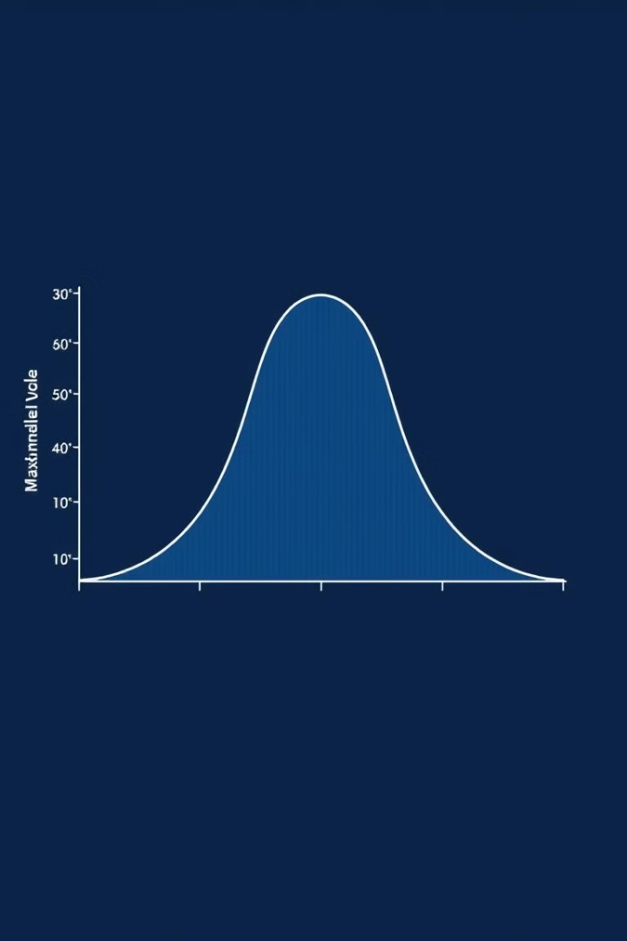
Parameter Estimation in Logistic Regression: Maximum Likelihood Estimation
1
Likelihood Function
The likelihood function measures how likely the observed data is given a set of parameter values.
2
Optimization
The goal of maximum likelihood estimation is to find the parameter values that maximize the likelihood function.
3
Iterative Algorithm
An iterative algorithm, such as gradient descent, is used to find the optimal parameter values.

Slide 5
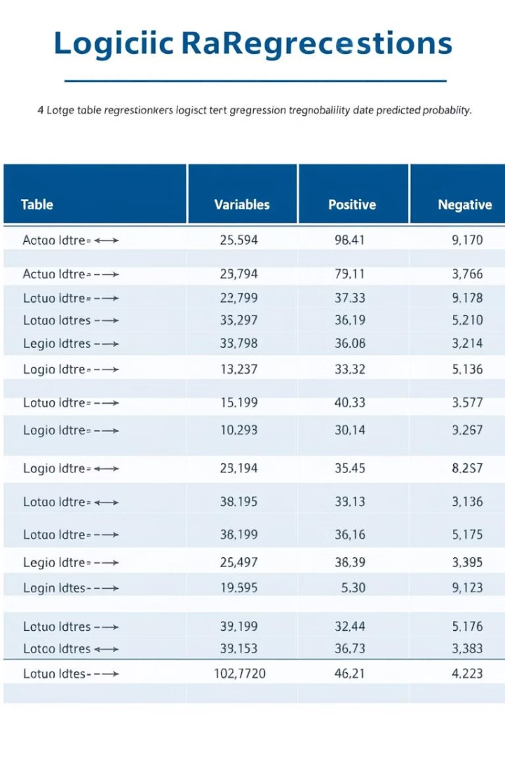
Interpreting Logistic Regression Coefficients
Coefficient
Interpretation
Positive
Increase in the independent variable increases the probability of the event occurring.
Negative
Increase in the independent variable decreases the probability of the event occurring.

Slide 6




Multinomial Logistic Regression (MNL)
Multiple Categories
MNL extends Logistic Regression to handle dependent variables with more than two categories.
Probabilistic Model
MNL estimates the probability of each category, given the values of the independent variables.
Categorical Prediction
The model predicts the most likely category based on the estimated probabilities.

Slide 7
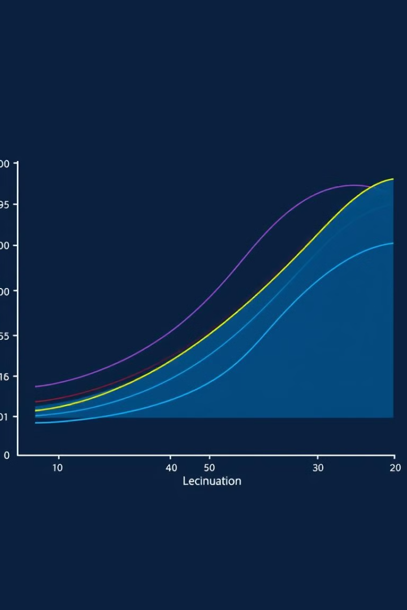
Ordinal Logistic Regression (Proportional Odds Model)
Ordered Categories
Cumulative Probabilities
Ordinal Logistic Regression handles dependent variables with ordered categories, such as low, medium, and high.
The model estimates the cumulative probability of being in a particular category or below.
Proportional Odds Assumption
The model assumes that the effect of the independent variables on the cumulative probabilities is proportional across categories.

Slide 8
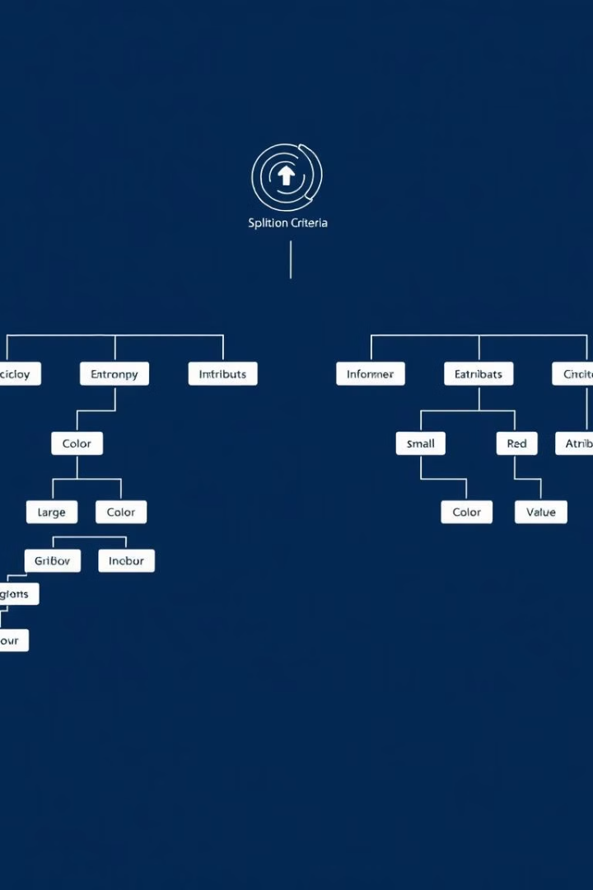



Decision Tree: Entropy, Information Gain, and Gini Index
Entropy
Entropy measures the impurity of a set of data, with higher entropy indicating greater uncertainty.
Information Gain
Information gain measures the reduction in entropy after splitting a node, indicating the usefulness of an attribute for classification.
Gini Index
The Gini index measures the probability of misclassifying a randomly chosen observation, with lower values indicating better classification.

Slide 9
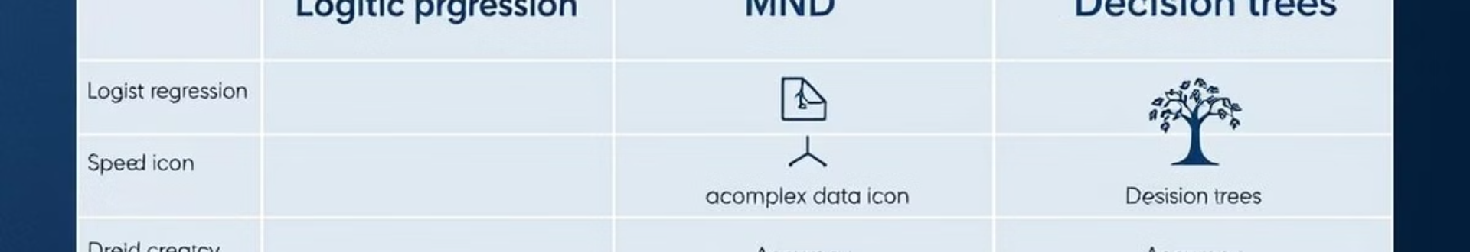
Conclusion: Comparing and Choosing Among Models
Model
Strengths
Weaknesses
Logistic Regression
Interpretable coefficients, robust to outliers
Assumes linear relationship, requires large sample size
MND
Handles multiple categories, flexible in modeling
Less interpretable, can be computationally intensive
Decision Tree
Easy to understand, handles both categorical and continuous variables
Prone to overfitting, sensitive to small changes in data

